Slide 1
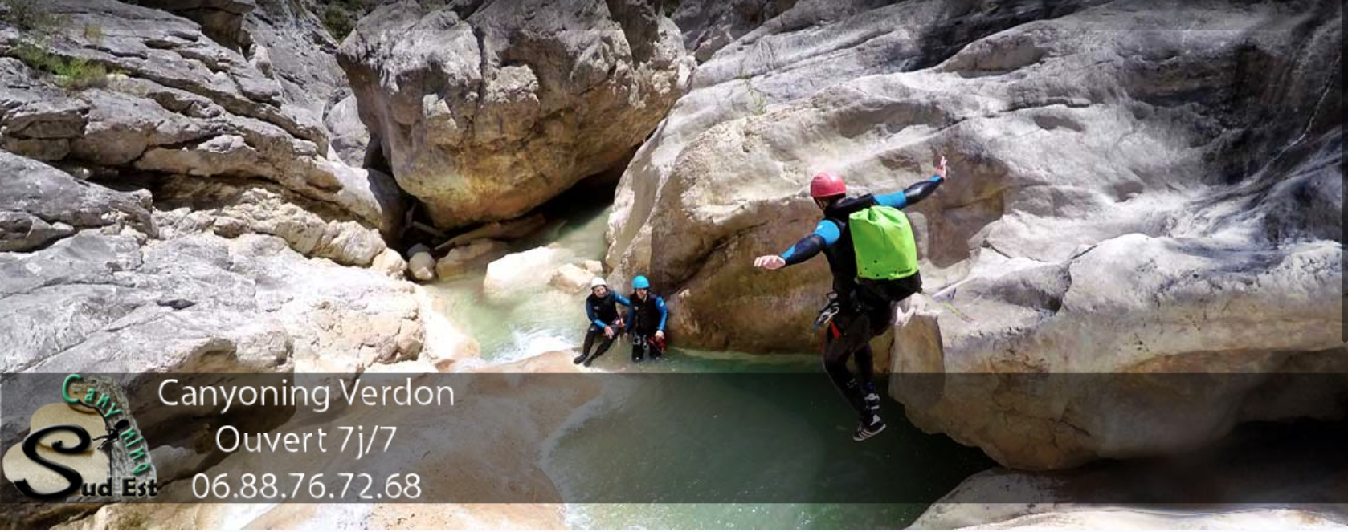

Canyoning Sud Est: Canyoning Verdon
(www.canyoningverdon.fr)
Digital Marketing for Small-sized businesses
Group 6 GERTNER Jules, LIN Qiyao, BANERJEE Joyee, EZ-ZERROUQI Zineb, MEKA MBALLA Gabriella

Slide 2
OUTLINE
INTRODUCTION
THE WEBSITE
DIGITAL ANALYTICS
DIGITAL REACH
DIGITAL UX/UI
RECOMMENDATIONS

Slide 3
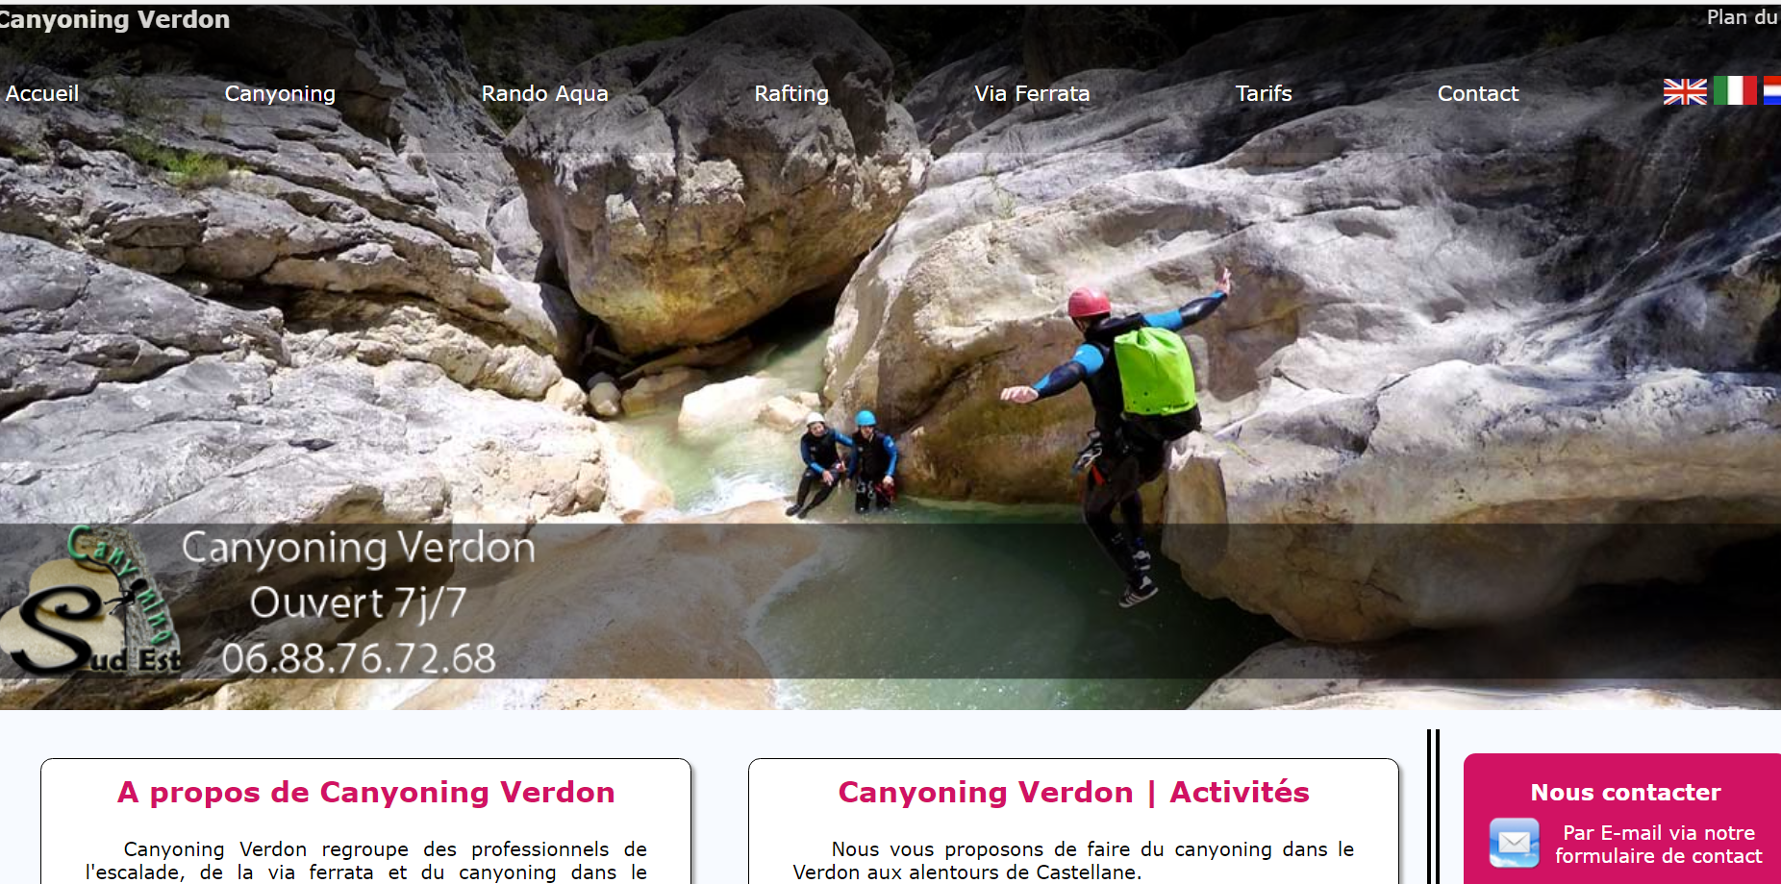
I. INTRODUCTION
VALUE PROPOSITION
BUSINESS MODEL
Canyoning Verdon offers outdoor activities including:
Rock-climbing
Canyoneering
Via-ferrata
Rafting
For:
beginners
intermediates
advanced adventurers
with the supervision of a guide
Different packages are available for each category.
Canyoning Verdon provides its services and packages directly to their consumers, thus it is requires an effective e-commerce strategy (B2C) for their storefront website.
BUSINESS SEASONALITY
User flow peaks for Summer holidays
Source: www.giphy.com,www.canyoningverdon.fr

Slide 4
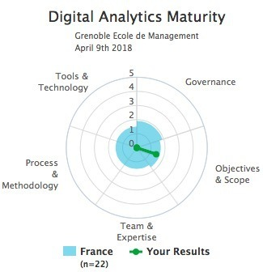
II. THE WEBSITE
PRESENT STATE
BUSINESS OBECTIVES
Simple Website with 62 pages cataloguing different activities offered
Website has been active since 6 years
Analytics has also been enabled since 6 years
Absence of clear defined goals
Absence of implementation of clear models to increase engagement and communication
Increase visibility of its’ offerings (increase brand awareness increased engagement and concise targeted content)
Attract new customers: (via Lead Generation-enquiry forms, direct calls)
From April till September
From France
Foreigners visiting the French Riviera
Drive website visitors into future customers (conversion)
Increase customer perceived value (create credibility)
Source: Stéphane Hamel Web Analytics Maturity Model

Slide 5
II. THE WEBSITE
ROLE OF DIGITAL MARKETING: FUTURE
Search Engine Marketing(SEM) & Social Media Marketing Increase online visibility
People interested in canyoneering and rock climbing easily find website
Call-To-Actions(CTA) can drive website users to make a reservation get converted to new customers
Possibility to better segment target audience
Assess the performance of website features

Slide 6
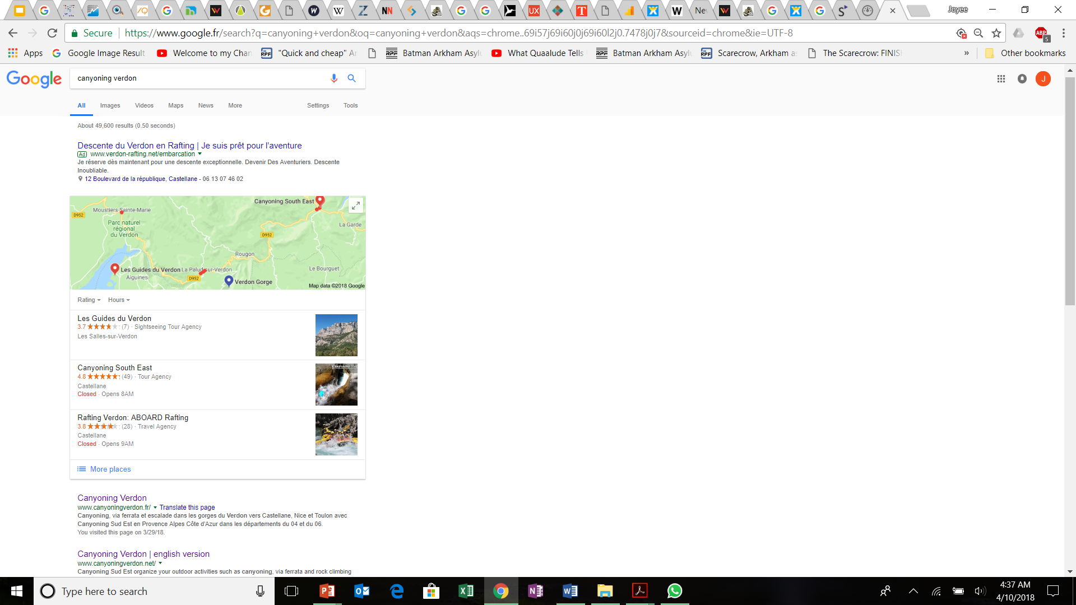
II. THE WEBSITE
WEBSITE:STRENGTHS
MARKETING | COMMENTS
Organic search | the business appears on the first page for many different trending keywords, proof with google trends good results on all Google pages and on different browsers
User Interface | lot of information provided information divided among several pages for easy consultation
Social Media | Some have a good amount of customer review& feedback
Source: Google

Slide 7
II. THE WEBSITE
WEBSITE:WEAKNESSES
PROBLEMS | COMMENTS
UX | Not easy to access Hard to access pictures and videos Too much text that could be replaced by engaging content Better website design through effective use of color theory and interactive design
UI | Position of information is not necessarily intuitive Navigation bar with huge gap Lack of search bar No clear call to action
Application of Analytics Data to improve Web Usability | Through linking Google analytics with Google Adwords and Google Search Console
Content | Can be better edited and organized No data filtering on google analytics (employees)
Social Media | Presence has low relevance and visits Presence can be effectively enhanced
Visibility | Could be improved through usage of Google Business, Yelp & Tripadvisor (linked only to the request canyoning sud est and not canyoning verdon and not linked to review websites)

Slide 8
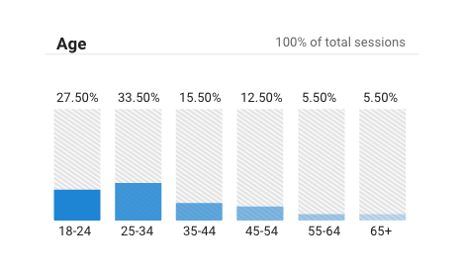
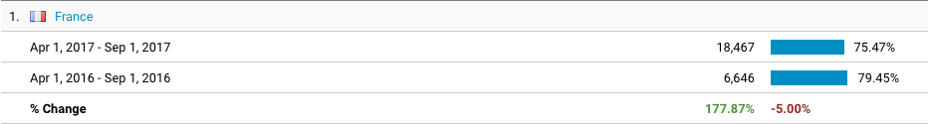
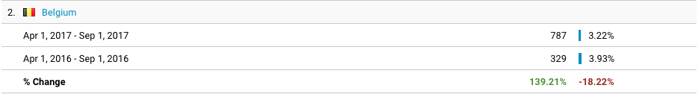
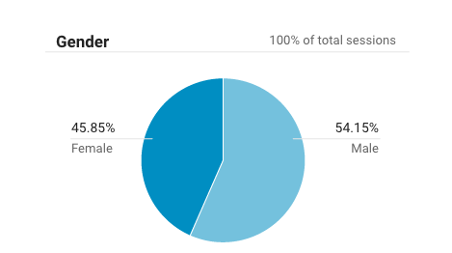
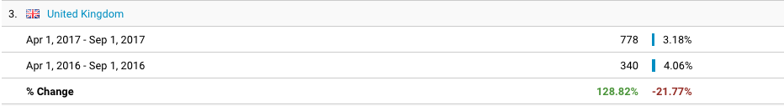
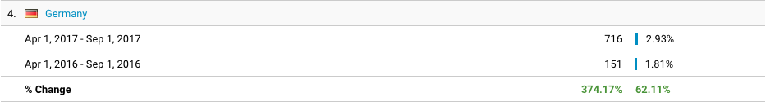
III. DIGITAL ANALYTICS
USER DEMOGRAPHICS
AGE
LOCALISATION
GENDER
Source: Google Analytics

Slide 9
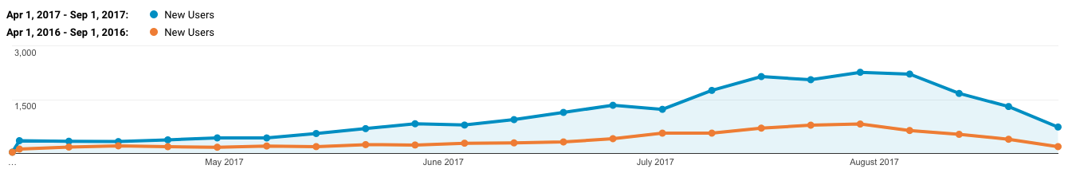
III. DIGITAL ANALYTICS
KPI BENCHMARK
New Users Benchmark April & September 2017
Canyoning Sud Est FY2017
New Users: 23,984 - +189%
Pages per session: 3.39 - +4.20%
Average Session duration: 3’19” - -4.48%
Bounce Rate: 46.60% - +3.48%
Source: Google Analytics
Benchmark Vs. CSE
New Users: 23,825 - +0.67%
Pages per session: 3.44 - -3.38%
Average Session duration: 2’22” - 40.12%
Bounce Rate: 53.79% - +13.36%

Slide 10
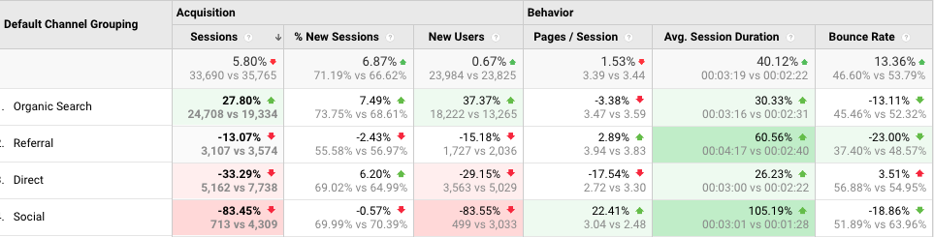
III. DIGITAL ANALYTICS
CHANNEL BENCHMARK
Source: Google Analytics

Slide 11
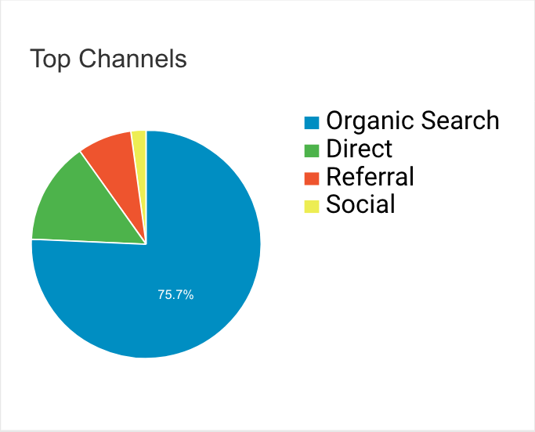
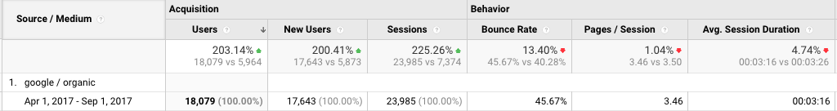
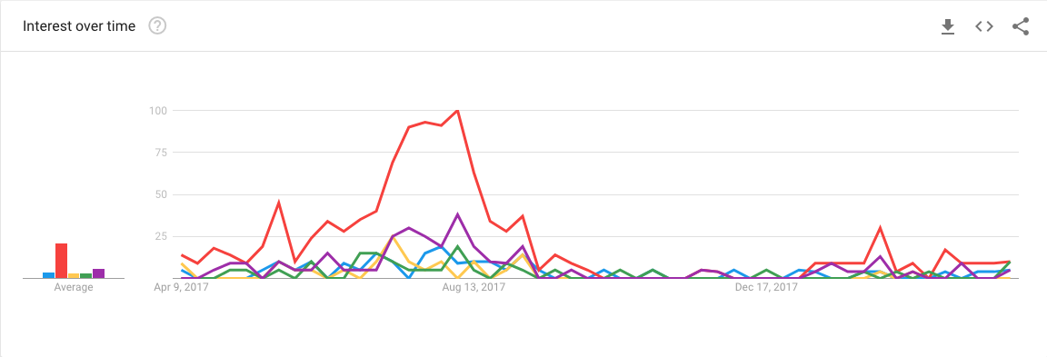
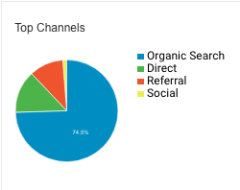
IV. DIGITAL REACH
ORGANIC SEARCH
2017
Organic traffic → Primary source of traffic
Local and seasonal business → Specific researches
Search Console queries → Activation of Google Search Console queries and link it to Google Analytics
New Users: 200.41% (17,643 vs 5,873
75.7%
2016
74.5%
Canyoning Nice - Canyoning Verdon - Canyoning Castellane-Via Ferrata Verdon - Canyoning Gorges du Verdon
Source: Google Analytics

Slide 12
IV. DIGITAL REACH
ORGANIC SEARCH
SERP TEST
 | Google.fr | Google.co.uk | Google.de?? | Yahoo.com
Canyoning France | 7th Position 1st Page | 6th Position 1st Page | 8th position 1st page | 2nd Position 2nd Page
Canyoning Castellane | 7th position 1st page (video 6th) | 7th Position 1st Page (video 5th) | 7th Position 1st Page (video 5th) | 7th Position 1st Page
Canyoning Verdon | 1st Position 1st page | 1st and 2nd position 1st page | 1st position 1st page | 1st, 2nd and 10th position 1st page
Canyoning Gorges du Verdon | 4th position 1st page | 3rd, 4th and 6th position 1st page | 3rd position 1st page | 1st and 10th position 1st page
Via ferrata Verdon | 2nd and 3rd position 1st page | 2nd and 3rd position 1st page | 2nd position 1st page | 3rd and 5th position 1st page
Top google trends for summer 2017:
Canyoning
Canyoning France
Gorges du Verdon
Top specific Google trends for Summer 2017:
Canyoning Castellane
Canyoning Verdon
Canyoning Gorges du Verdon
Via Ferrata Verdon

Slide 13
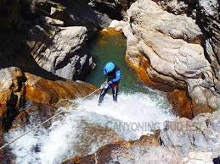
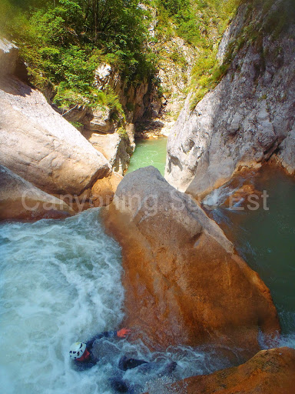
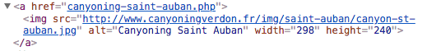
IV. DIGITAL REACH
ORGANIC SEARCH
SEO OPTIMIZATION OF PICTURES
All picture have short yet descriptive alternative texts
All pictures are found easily on Google image search
Site lacks of sitemap for images
Source: www.canyoningverdon.fr

Slide 14
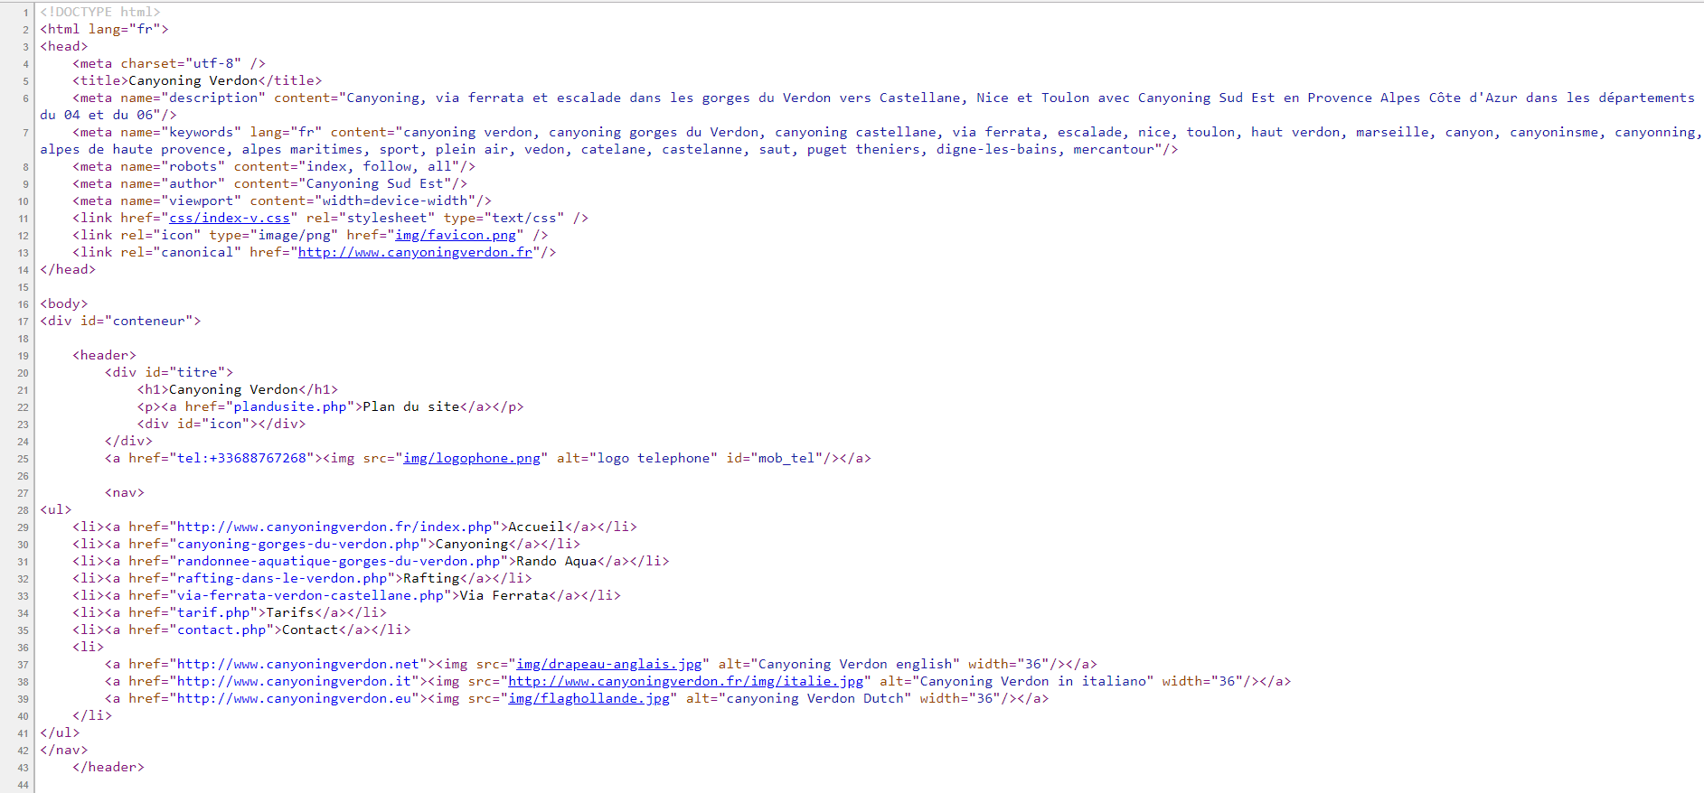
IV. DIGITAL REACH
ORGANIC SEARCH
SEO OPTIMIZATION
Title
Keywords
H1 Heading
Source: www.canyoningverdon.fr

Slide 15
IV. DIGITAL REACH
REFERALLS
100% Bounce Rate Spam Bots
White Hat SEO
Rank. Page name | Users
1.semalt.semalt.com | 908
7.buttons-for-websites.com | 433
12.success-seo.com | 185
14.www1.social-buttons.com | 169
16.best-seo-offer.com | 154
23.buttons-for-your-website.com | 93
27.rankings.analysis.com | 73
31.100dollarseo.com | 59
34.make-money-online.7makemoneyonline.com | 44
Rank Page name | Domain Score | Trust Score | Users
1.dmoztools.net | 52 | 57 | 7
7.seokicks.de | 30 | 33 | 0
12.boostersite.com | 29 | 27 | 10
Maxannu.con | 27 | 24 | 3
Ladenise.com | 27 | 28 | 0
Canyoning Sud Est Ecosystem | X | X | 1872
Castellane.org | x | x | 133
Canyon-blog.org | X | X | 120
http://www.descente-canyon.com/ | X | X | 49
Source: Google Analytics

Slide 16
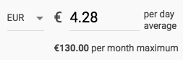
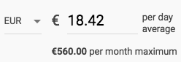
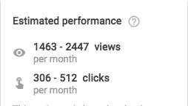
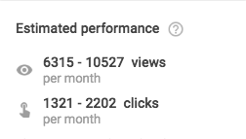
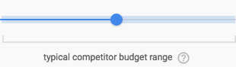
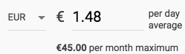
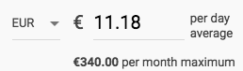
IV. DIGITAL REACH
GOOGLE ADWORDS
Google adwords optimization:
Adwords Quality Score → Niche keyword list
Specificity → Long-tail keywords
Negative Keywords → “Not activities”
Landing Page optimization → CTR
Relevancy of linking Google Adwords to Google Analytics:
Measure Click-Through-Rate
Measure Bounce Rate
Funnel analysis
Source: Google Analytics

Slide 17
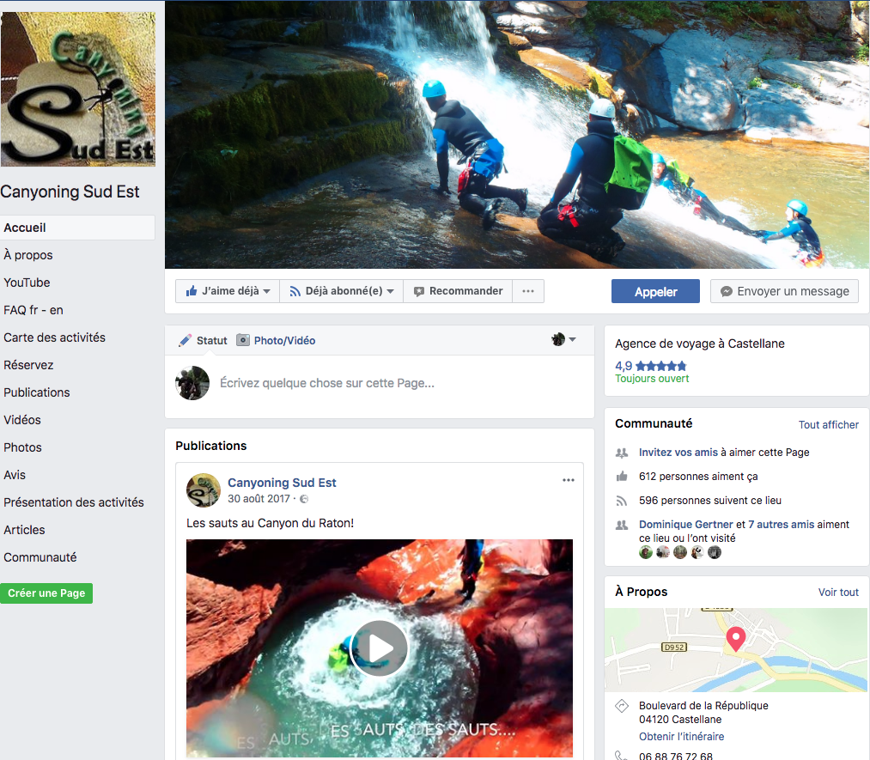
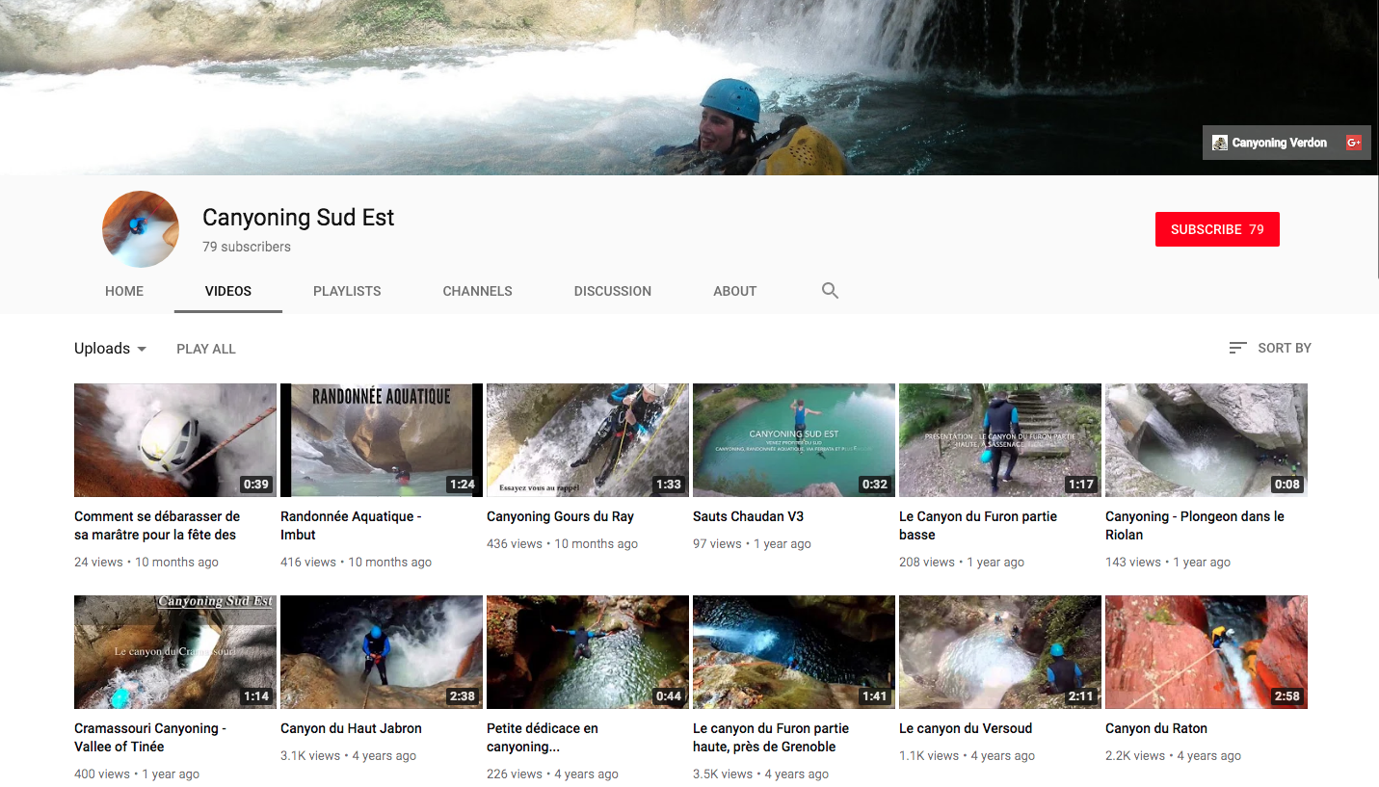
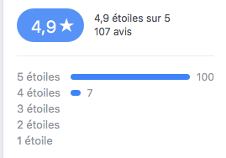
IV. DIGITAL REACH
SOCIAL MEDIA
Facebook
YouTube
Source: Facebook Canyoning Sud Est

Slide 18
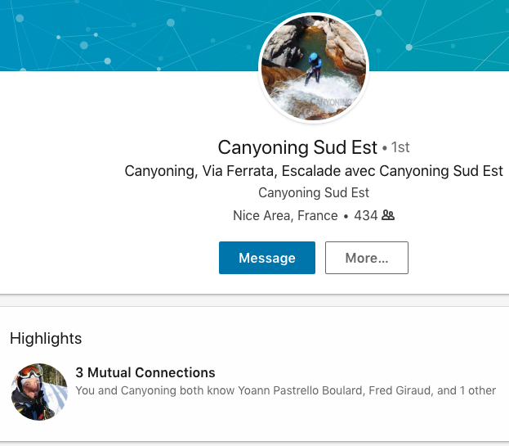
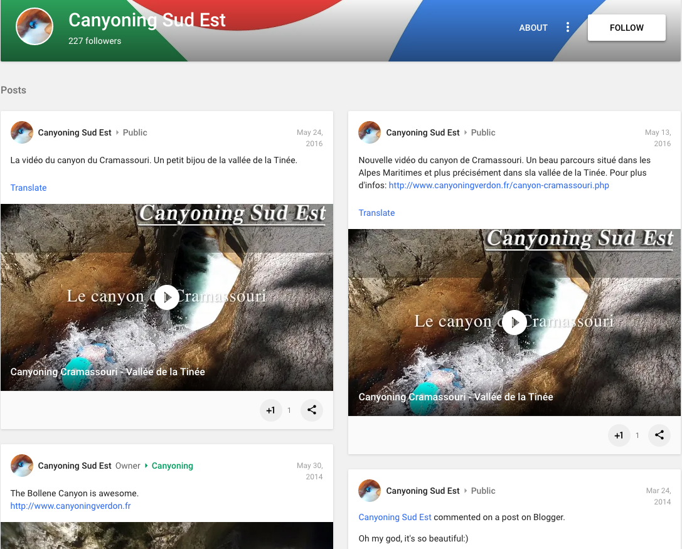
IV. DIGITAL REACH
SOCIAL MEDIA
LinkedIn
Google Plus
Source: LinkedIn Canyoning Sud Est
Source: Google plus Canyoning Sud Est

Slide 19

IV. DIGITAL REACH
SOCIAL MEDIA
Facebook Analysis
APRIL-SEPTEMBER 2015
APRIL-SEPTEMBER 2016
Profile Picture & Cover Photo | Provided
About Description | Provided
CTA Message | Provided
Milestones | Missing
Location | Provided
Activity | Missing
Response | Users can post
Best Performing Social Media : Facebook
New users : 73 users in 2015 to 92 users 2016
Bounce Rate : 47.71 % in 2015 to 54.14% in 2016
Average Session Duration : 00.01.56 in 2015 to 00.04.16 in 2016
Change of 26.03%
Change of 120.08%
APRIL-SEPTEMBER 2016
APRIL-SEPTEMBER 2017
Use Facebook as a great tool for events.
Does not interact with other Facebook Pages.
Could use a lot more variation in types of content posted, every day with a range of 40 to 100 characters to produce engagement with customers.
Best Performing Social Media : Facebook
New users : 92 users in 2016 to 462 users 2017
Bounce Rate : 54.14 % in 2016 to 52.09% in 2017
Average Session Duration : 00.04.16 in 2016 to 00.03.05 in 2017
Change of 402.17%
Change of (-27.91%)
Source: Facebook Insights

Slide 20


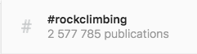
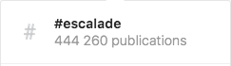

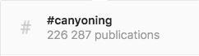




IV. DIGITAL REACH
SOCIAL MEDIA
Potential Performing Social Medias
Keeping the development of exclusive features/content
Integrating conversion measurement.
Focusing on posting schedules and best upload times.
Match the post and the format to the proper network.
Focusing on visual content : make impactful images and pictures.
Entend website reach with Hashtags
hashtags
enquiries and links
Non-Performing Social Medias
Low visitors, likes and views
No leads to the Canyoning Verdon Website
Source: YouTube, Instagram, Google plus, Twitter, LinkedIn
Source: Facebook Insights

Slide 21
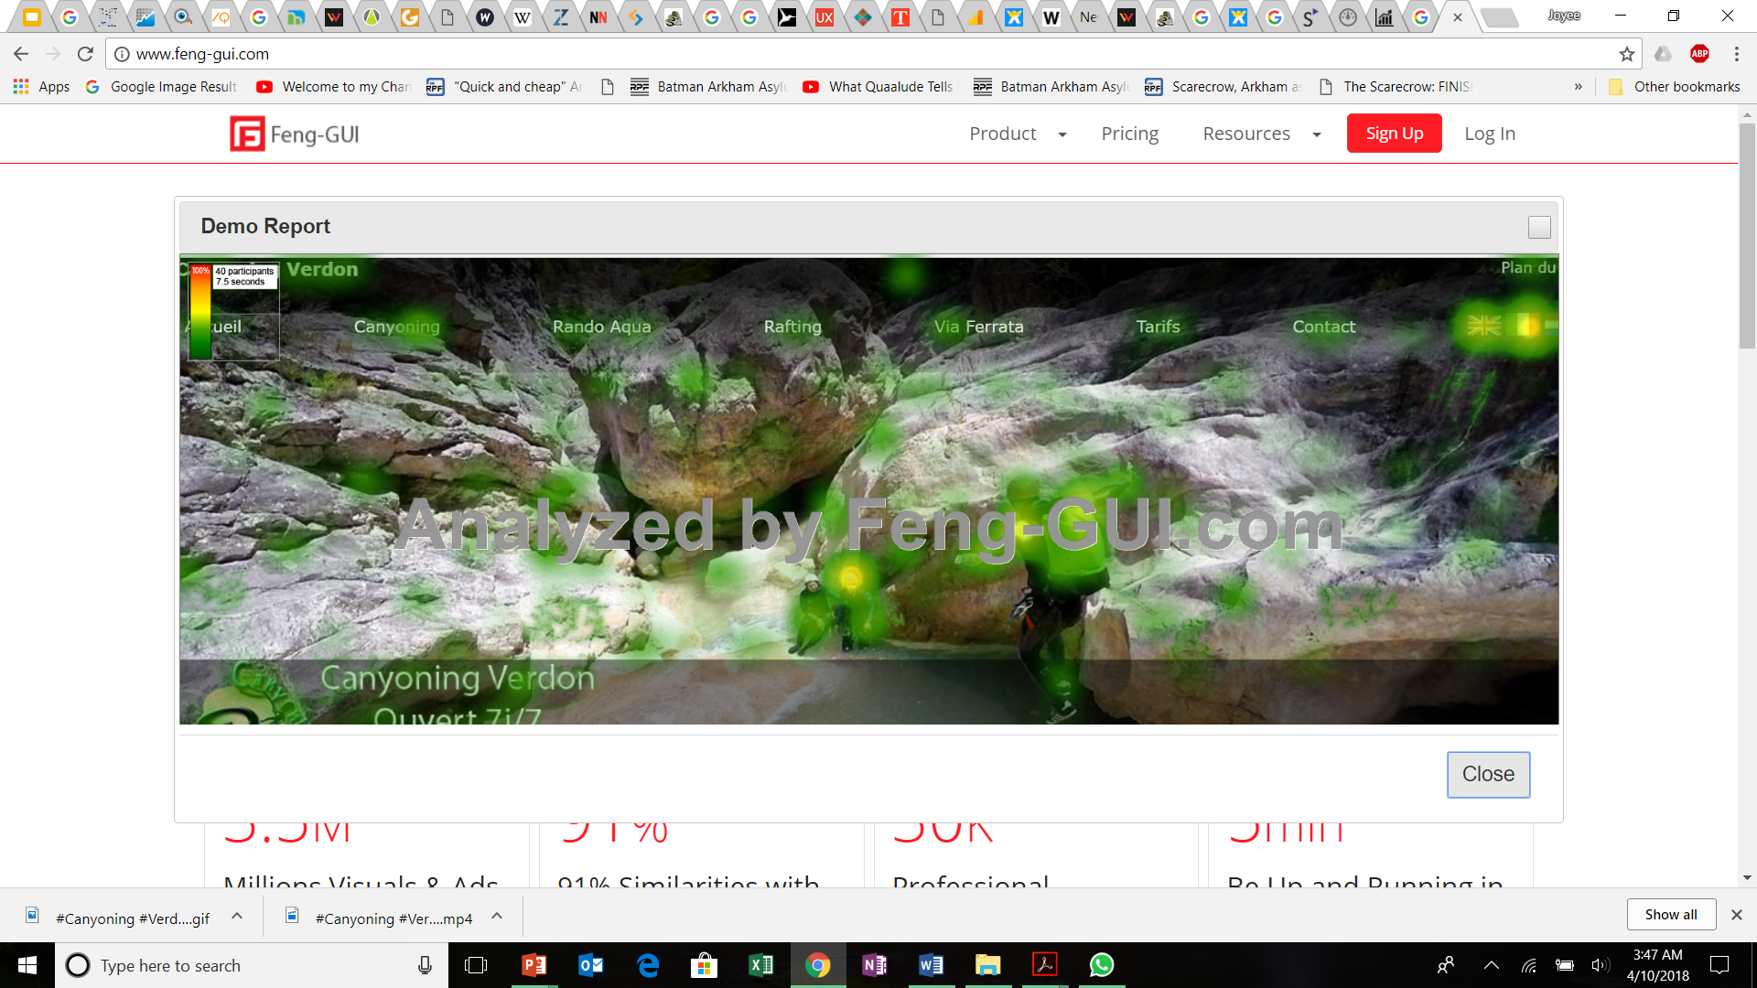
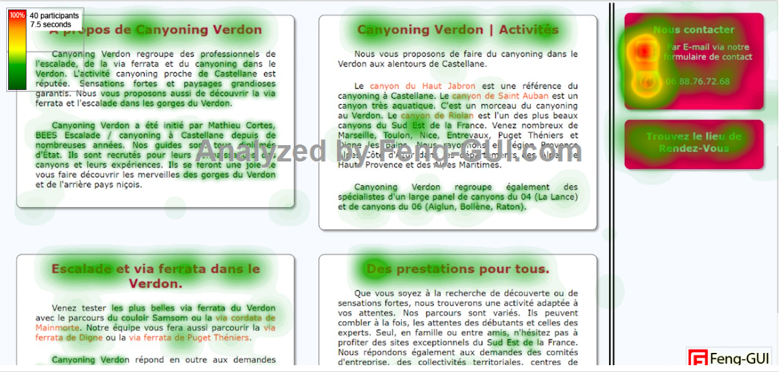
V. DIGITAL UX/UI
CURRENT WEBSITE OVERVIEW
HEATMAP
Brand Logo does not attract attention
Hyperlinks within the text is not evident
Highest Focal Point on upper right hand side and on icons (Contact icons and country flags attract attention)
Too much text is misleading the visitors
Source: www.feng-gui.com

Slide 22
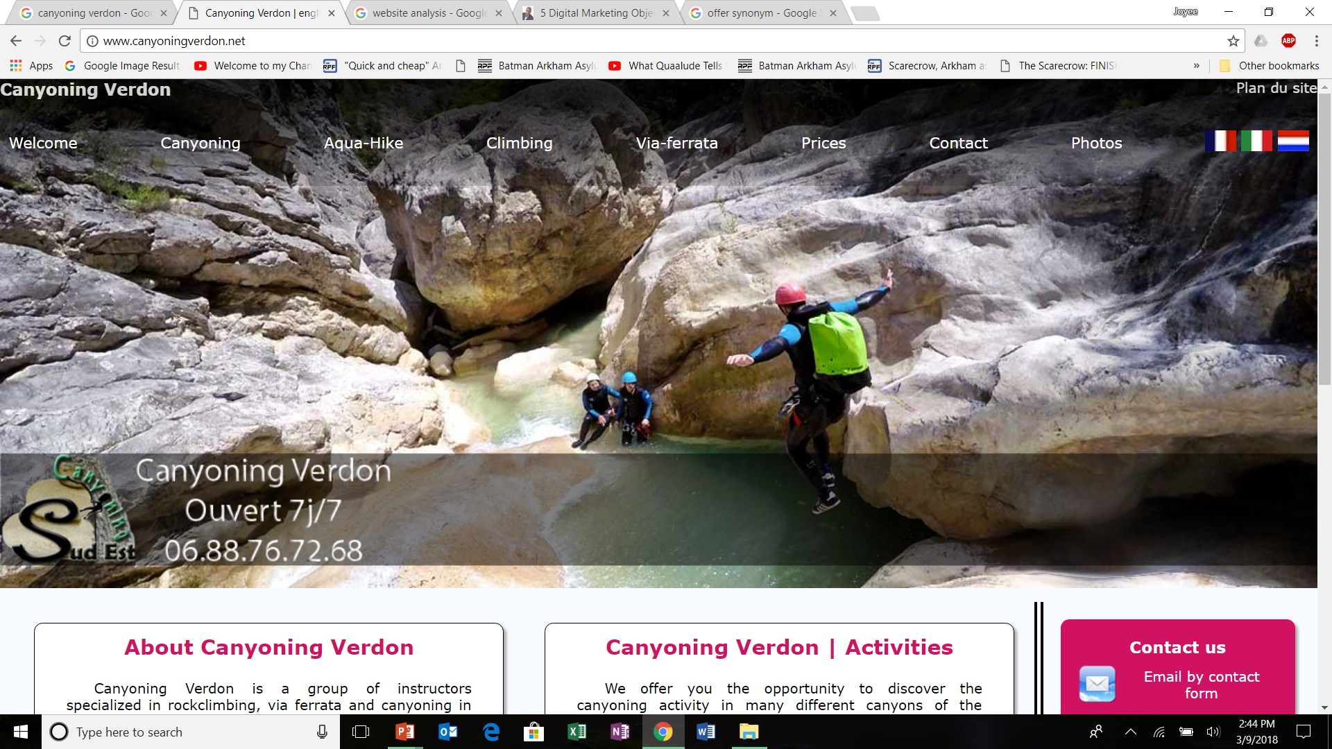
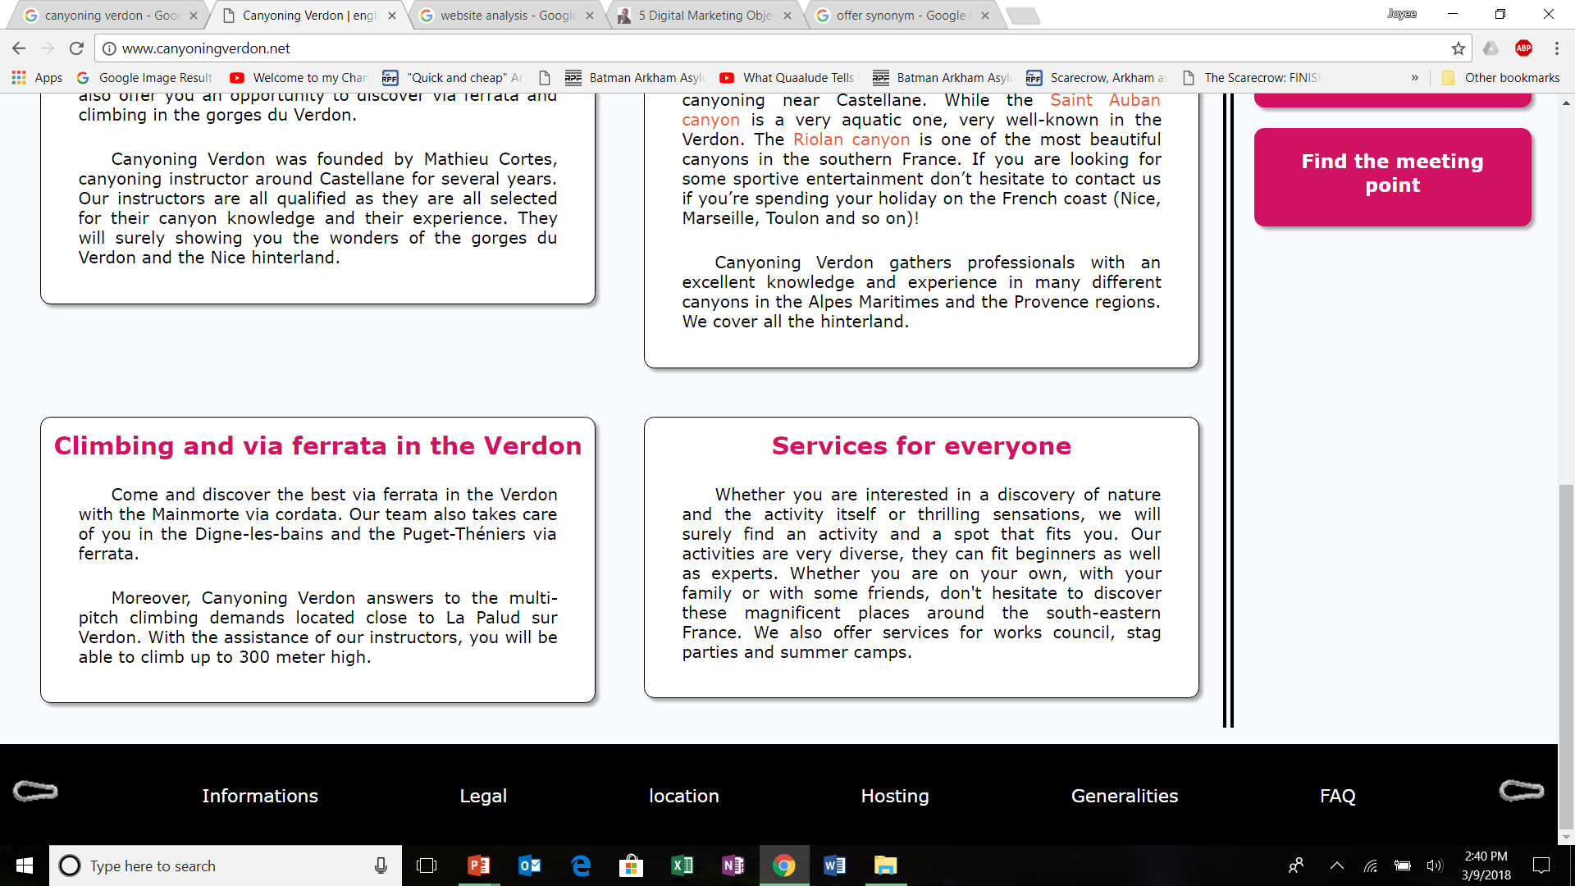
V. DIGITAL UX/UI
CURRENT WEBSITE OVERVIEW
Design, Layout & Content Issues : Landing Page
Navigation bar not clear
Logo is not clear and positioning does not capture attention
Call to Action Button is not clear
Description is too haphazard
Use of colours is not complementary
Navigation Bottom bar unclear, unreadable and does not serve the purpose
Search Bar is not present
Source: www.canyoningverdon.fr

Slide 23
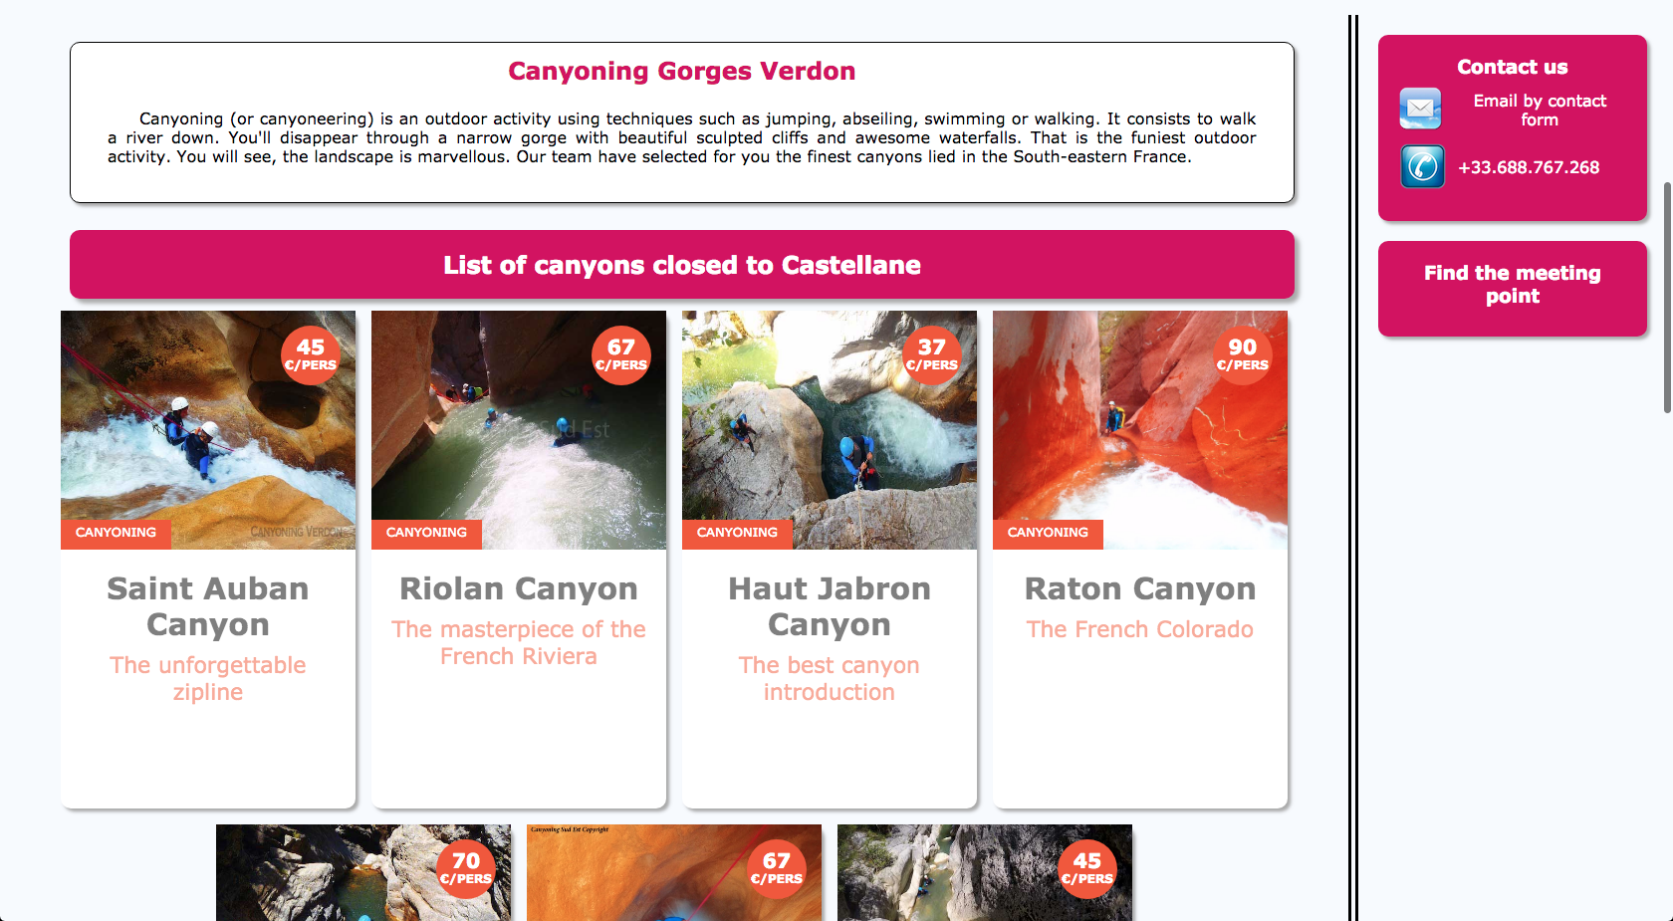
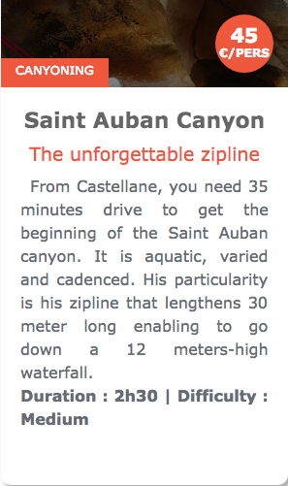
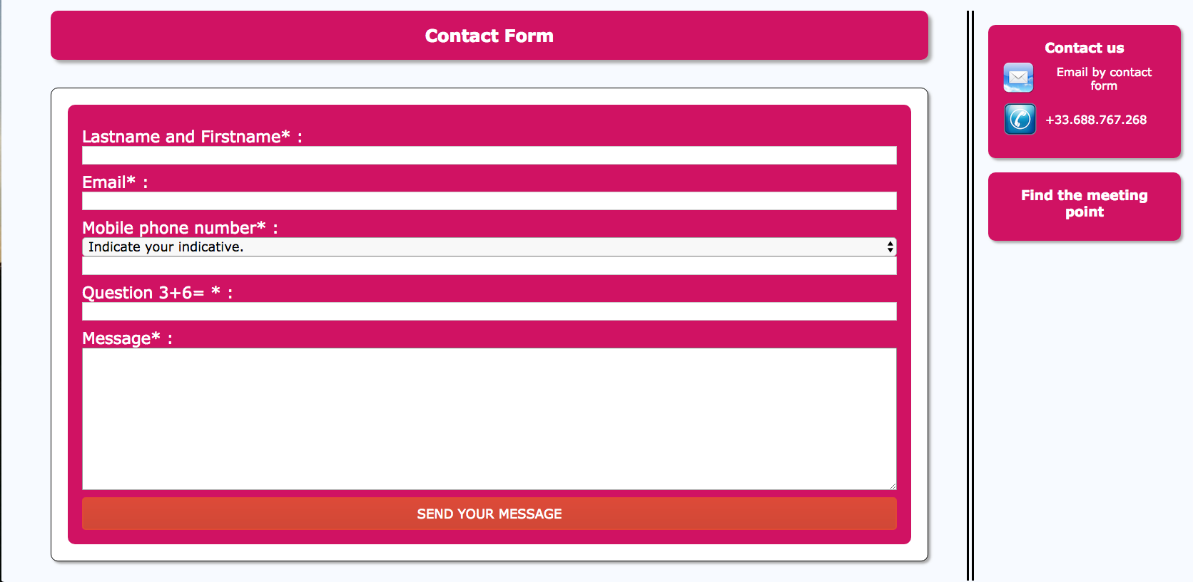

V. DIGITAL UX/UI
CURRENT WEBSITE OVERVIEW
Grammar check
Bounce Rate: 43.5%
Avg Time on Page: 1 minute
Saint Auban and Riolan represent most of the traffic(12.9%& 10%)
High CTR(78% and 63%)
Design, Layout & Content Issues: Main Activity & Contact Page
Poor color theory usage → Should use stimulating color
Confusing verification question
Source: www.canyoningverdon.fr

Slide 24
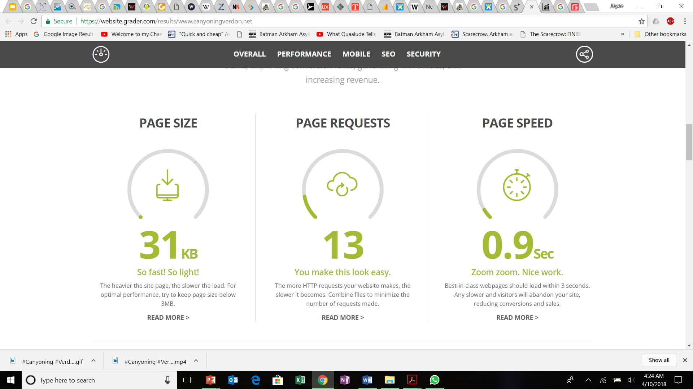
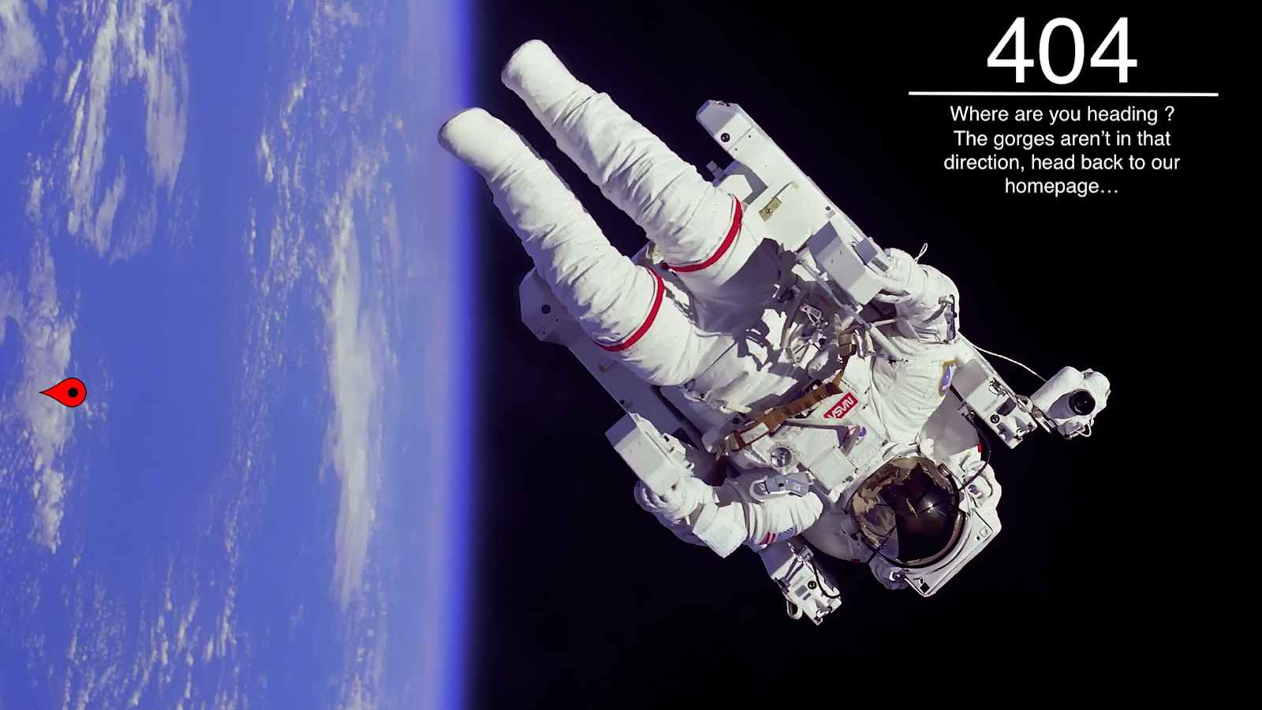
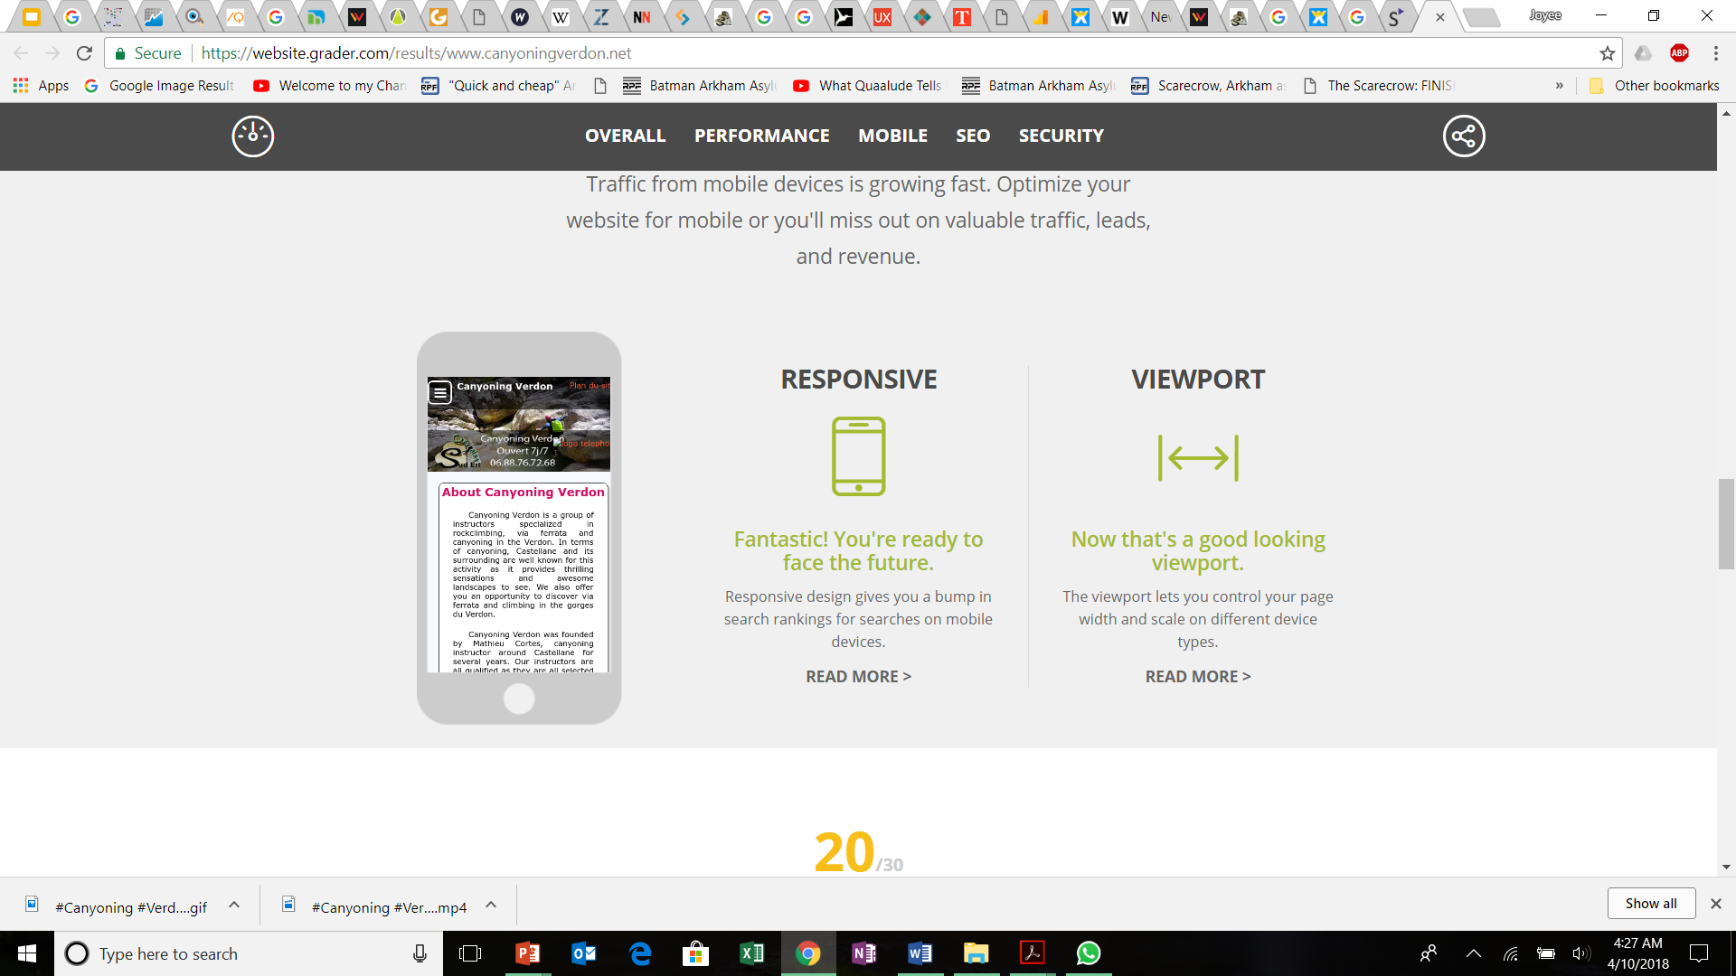
V. DIGITAL UX/UI
OVERVIEW
GENERAL RESPONSE
GENERAL RESPONSE
MOBILE FRIENDLINESS
Source: website-grader.com

Slide 25
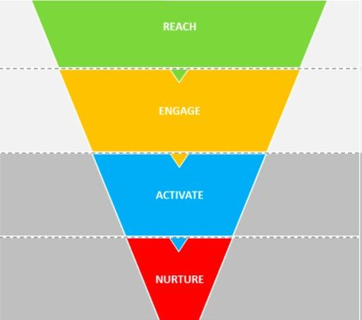
RECOMMENDATIONS
REAN Model
Conversion Goals
Be able to evaluate the number of customers who come from organic search and social media channels both from France and other places .
Organic search, social media.
Web pages and phone web pages, social media.
Aiming that 20% of people visiting the website should be able to click on our webpages .
Call the phone number.
Fill the contact form.
Activate a majority of 40% of customers to call the phone number in order to establish more direct contact
Recommendation to other potential customers.
Nurture customers to recommend our websites to other customers coming from France and other parts of the world

Slide 26
RECOMMENDATIONS
SEO
TOP ORGANIC KEYWORDS
KEYWORD | POSITION | VOLUME GENERATED
canyoning verdon | 1 | 2,400
canyon verdon | 1 | 210
canyoning | 22 | 27,100
verdon canyoning | 3 | 110
canyoning castellane | 9 | 260
On page optimization can be improved through use of tags (Title, Description, Image etc.)
Use targeted key words (avoid repetitive use)
Focused keywords to be updated periodically
Use Heading Tags(H1,H2..) effectively with incorporation of keywords
Use meta tags to efficiently summarize content and create unique meta tags for each page
Improve URL structure to allow better crawling
Implement Easy Navigation through .XML Sitemap and use of breadcrumbs
Use of targeted keywords in Text and text should be concise and updated periodically to maintain engagement
Organic Search Results can be increased through improved backlinking
ORGANIC SEARCH POSITION - KEYWORDS
KEYWORD | POSITION | VOLUME GENERATED | TRAFFIC % | TOTAL RESULTS
canyoning verdon | 1 | 2,400 | 63.01% | 150,000
canyon verdon | 1 | 210 | 5.47% | 447,000
canyoning gorges du verdon | 3 | 1,000 | 5.02% | 102,000
canyoning | 22 | 27,100 | 2.23% | 8,280,000
via ferrata verdon | 2 | 260 | 1.84% | 75,000
gorges du verdon canyoning | 3 | 320 | 1.56% | 100,000
Source: SEMrush

Slide 27
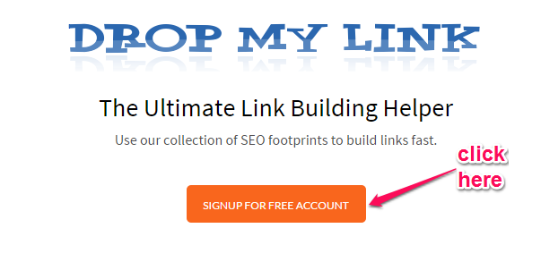
RECOMMENDATIONS
Referrals
Paid Search
Efficient AdWords campaign to be implemented during peak seasonality
Google Analytics account to be linked to AdWords account to measure conversion rate
Use of targeted relevant keywords to attract new customers
Increase referrals by getting published by review sites, online directories, personalized customer blog posts, social media generate sales
Incorporate referral widget within website and implement referral marketing plan
Use of relevant referrals to increase traffic from related categories
Source: nielpatel.com
Social Media
UX/UI
Use of effective customer review panels
Relevant and Interactive content updated regularly to engage potential customers
Use of hast-tags on pictures and posts to direct interested traffic
Use of SMO(Social Media Optimization) by using Facebook, Instagram, YouTube insights, use of keywords, hashtags and interesting content
Redesign website
Clearly positioned CTA to increase response
Usability checklists to measure performance

Slide 28
RECOMMENDATIONS
OVERALL
Enable DASHBOARD in google analytics
Set GOALS
in google analytics
New Redesigned Website
Segment Customers
Activate STAFF SEARCH FILTER in google analytics
Activate SEARCH CONSOLE in google analytics
Set SALES FUNNEL for easier conversion
Increase Conversion

Slide 29
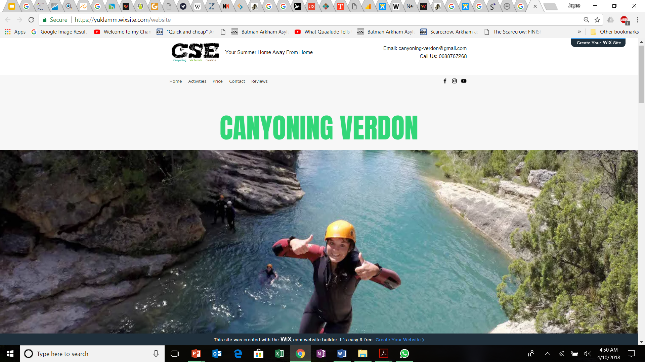
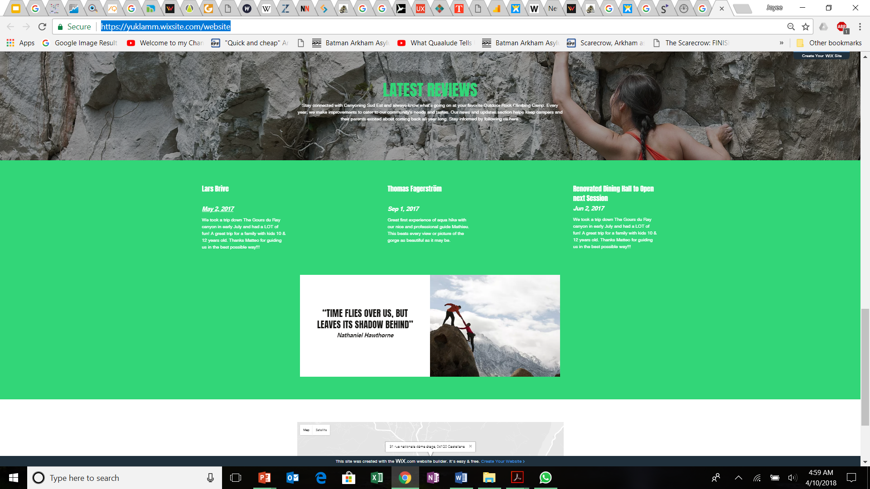

WEBSITE REDESIGN
Looking Ahead
https://yuklamm.wixsite.com/website
REDESIGNED LOGO:
REVIEW SECTIONS ADDED:
https://yuklamm.wixsite.com/website
Source: wixsite.com

Slide 30

https://yuklamm.wixsite.com/website
THANK YOU

